Slide 1

Preliminary Presentation on Project on
“SMART WHEELCHAIR AND HOME AUTOMATION FOR PARALYZED”
Presented by
24. JASIRA T P
34. NAYANA RAMESHAN
46. SHRAVAN SREEDEEP
48. SOORYA P
under the guidance of
Dr. C SREEKUMAR
DEPARTMENT OF ELECTRICAL & ELECTRONICS ENGINEERING
GOVT. COLLEGE OF ENGINEERING KANNUR- 670563
Oct 2021

Slide 2
Overview
Introduction
Objectives
Literature Review
Modified Scheme
Smart Wheelchair
Status of Project Work
Work Plan
Conclusion
Reference

Slide 3
INTRODUCTION
Paralyzed stroke patients are unable to normally communicate with their environment.
Part of their body that is under their control is their eyeballs.
Basic day to day operations are switching on basic devices like fan, bulb etc.
Smart Wheel Chair is the solution that we are proposing for these problems.

Slide 4
OBJECTIVES
To track eye movement and control basic devices like bulb, fan etc.
To design and implement an autonomous electric wheelchair.
To control the electric wheel chair by tracking eye movements.

Slide 5
LITERATURE REVIEW
[1]Tan Kian Hou, Yagasena and Chelladurai, “Arduino based voice controlled wheelchair”, IEEE, 2019
Smart motorized voice controlled wheelchair.
Voice command controls the movements of the wheelchair.
Microcontroller used is Arduino Uno.

Slide 6
LITERATURE REVIEW
[2]Ahmad F. Klaib, Nawaf . Alsrehin, Wasen Y. Melhem, Haneen Bashtawi, Aws A. Magableh, “Eye Tracking Algorithms, Techniques, Tools, and Applications with an Emphasis on Machine Learning and Internet of Things Technologies”, September 2020.
Machine learning and the Internet of Things are essential factors in the development of eye tracking applications.
This eye tracking techniques have more accurate detection results compared with traditional event-detection methods.

Slide 7
LITERATURE REVIEW
[3] Mohammed Hayyan Al Sibai, Sulastri Abdhul Manap, “A Study on Smart
Wheelchair Systems”, Research Gate Dec 2015
Presented different smart technologies for wheelchairs.
The human - machine interface and the navigation methods and devices, were the two key areas of concentration.

Slide 8
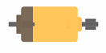
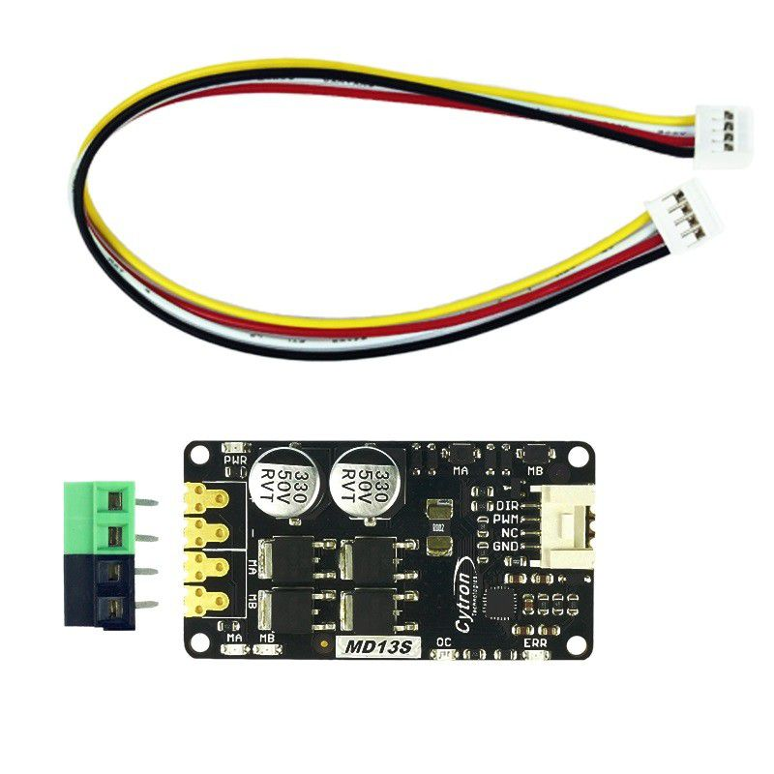
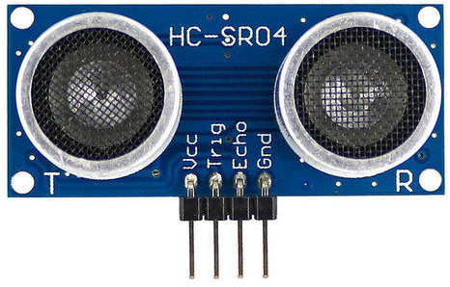
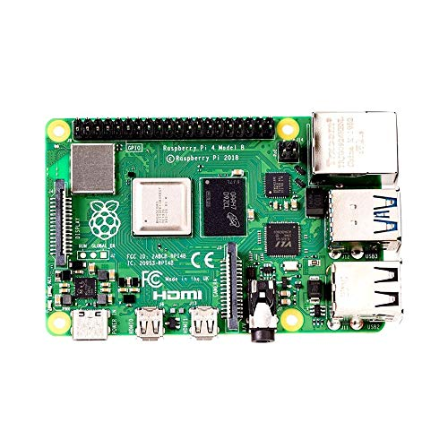
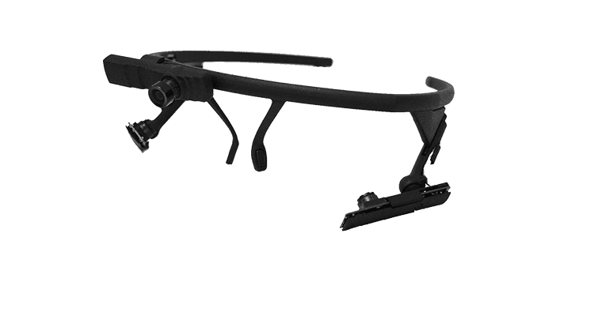
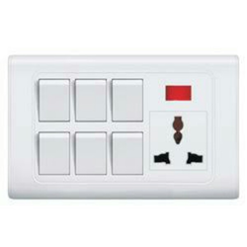
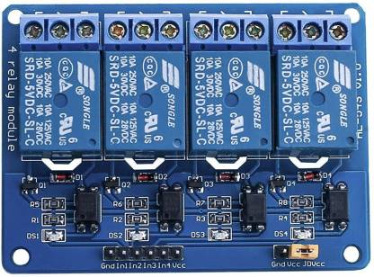
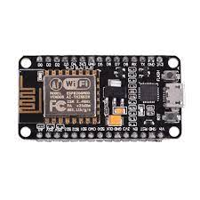
MODIFIED SCHEME
×8
LEFT MOTOR
DC MOTOR DRIVER
CAMERA MODULE
RIGHT MOTOR
RASPBERRY PI 4
RELAY CIRCUIT
NODE MCU
Fig 1. Block Diagram of Smart Wheelchair

Slide 9
SMART WHEELCHAIR
The whole project is divided into 3 parts
Eye tracking module using Raspberry Pi 4
Home automation system using Node MCU and Bluetooth Module
Wheel Chair

Slide 10
SMART WHEELCHAIR
Eye tracking module using Raspberry Pi 4
Camera Module is used to capture eye movements.
The eye movement is tracked using the python eye tracking model using Raspberry Pi 4.
The position of the pupil is transferred to Node MCU using Bluetooth module.

Slide 11
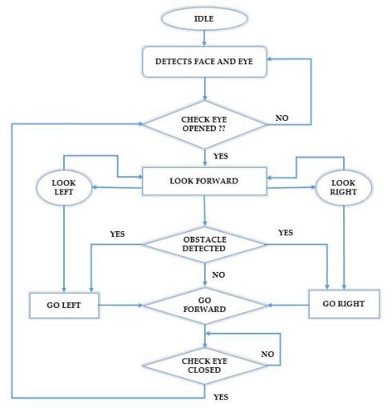
Flow Chart of Eye tracking program

Slide 12
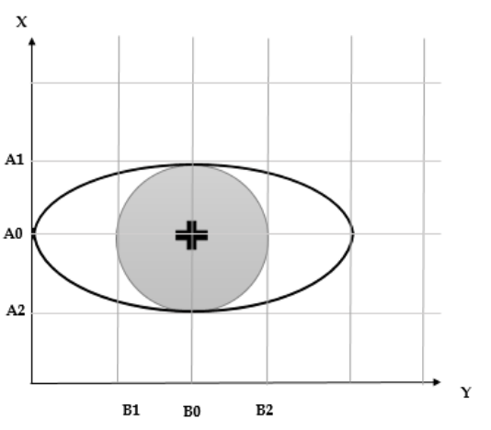
Detection of pupil in tracking program

Slide 13
SMART WHEELCHAIR
Wheel Chair
Wheel chair is also controlled on the basics of the control signal received from Raspberry Pi 4.
The wheel chair have low speed for safety.
8 ultra sonic sensors are connected in 4 directions of the wheelchair for obstacle and pit detection.
Incase an obstacle is identified the wheel chair stops and correct trajectory.

Slide 14
SMART WHEELCHAIR
Home automation system using Node MCU and Bluetooth Module
From the position received from Raspberry Pi 4, appropriate decision is taken by the Node MCU.
Control by Node MCU include the switches of light and fan.

Slide 15
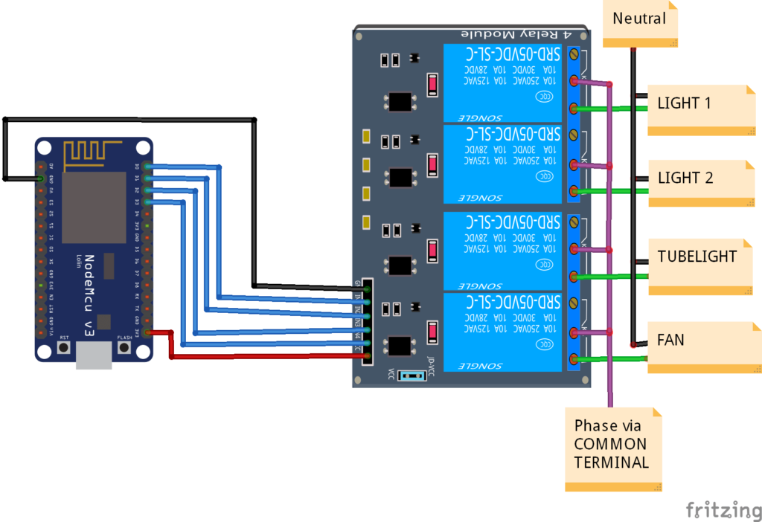
Home automation system using Node MCU and Bluetooth Module

Slide 16
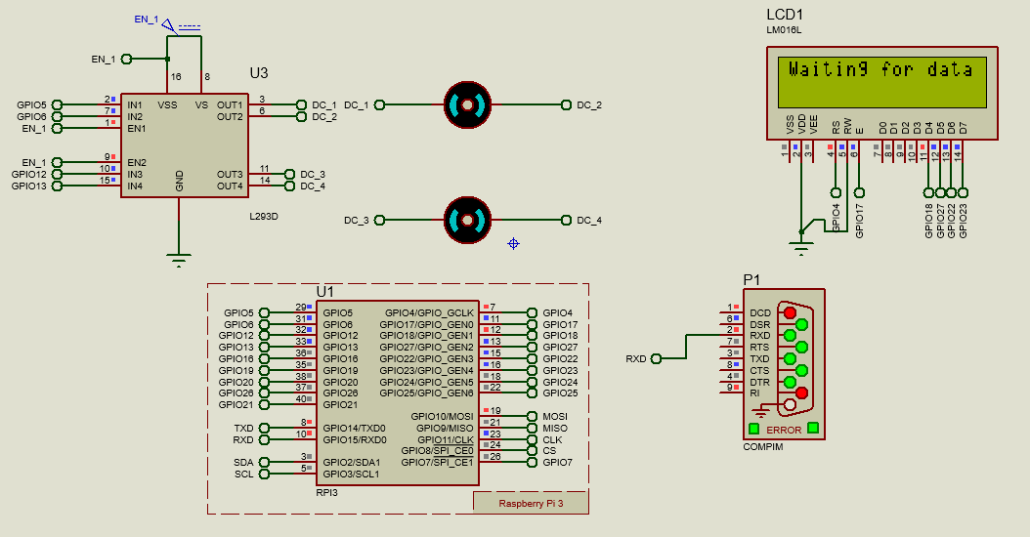
STATUS OF PROJECT WORK
Simulation of Smart Wheel Chair
Fig 4.1 Simulation Model of Smart Wheelchair

Slide 17
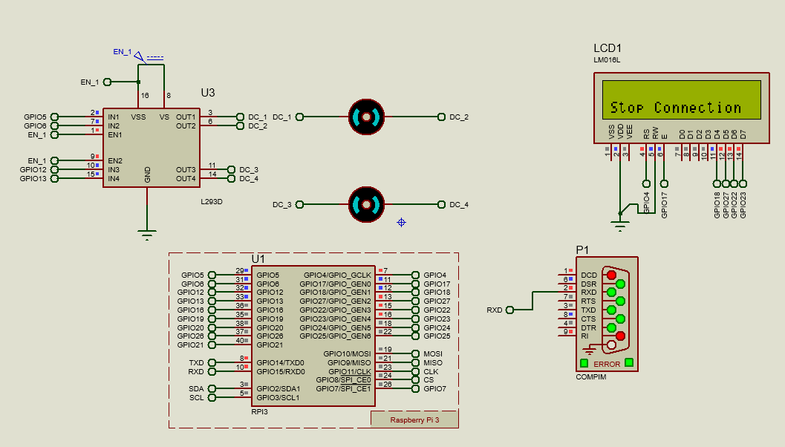
STATUS OF PROJECT WORK
Simulation of Smart Wheel Chair
Fig 4.1 Simulation Model of Smart Wheelchair

Slide 18
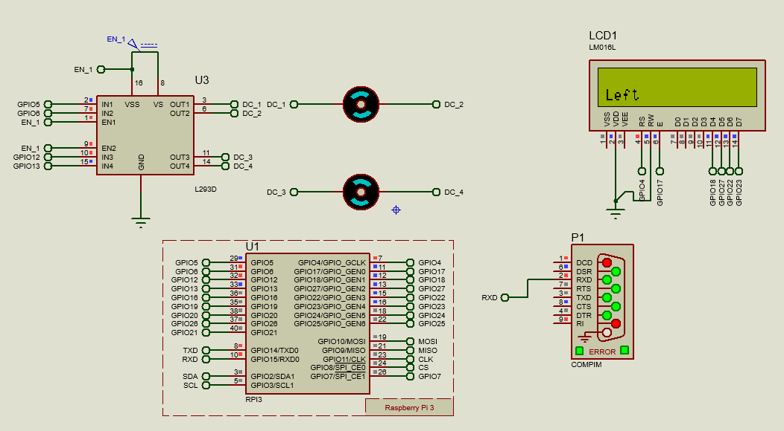
STATUS OF PROJECT WORK
Simulation of Smart Wheel Chair
Fig 4.1 Simulation Model of Smart Wheelchair

Slide 19
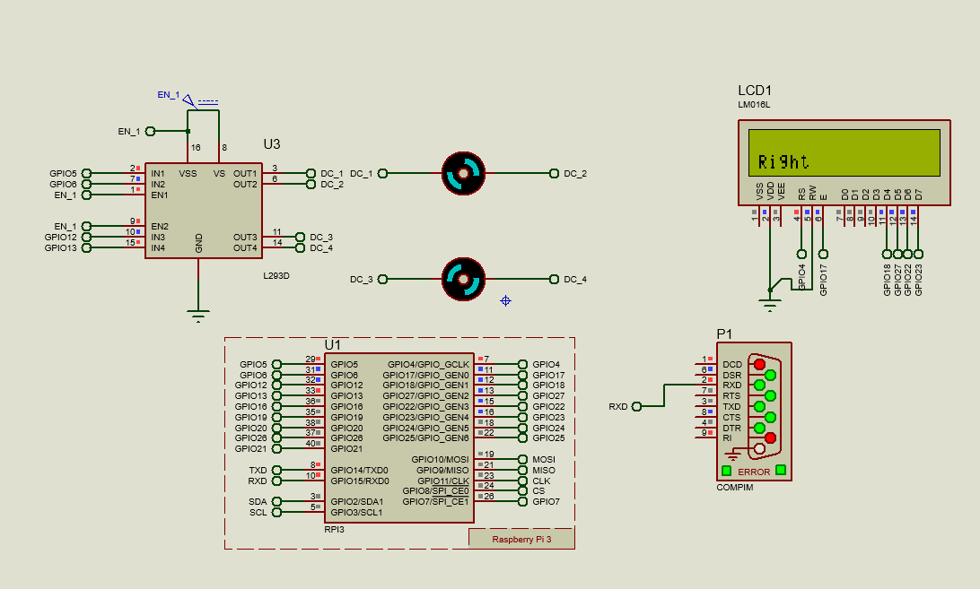
STATUS OF PROJECT WORK
Simulation of Smart Wheel Chair
Fig 4.1 Simulation Model of Smart Wheelchair

Slide 20
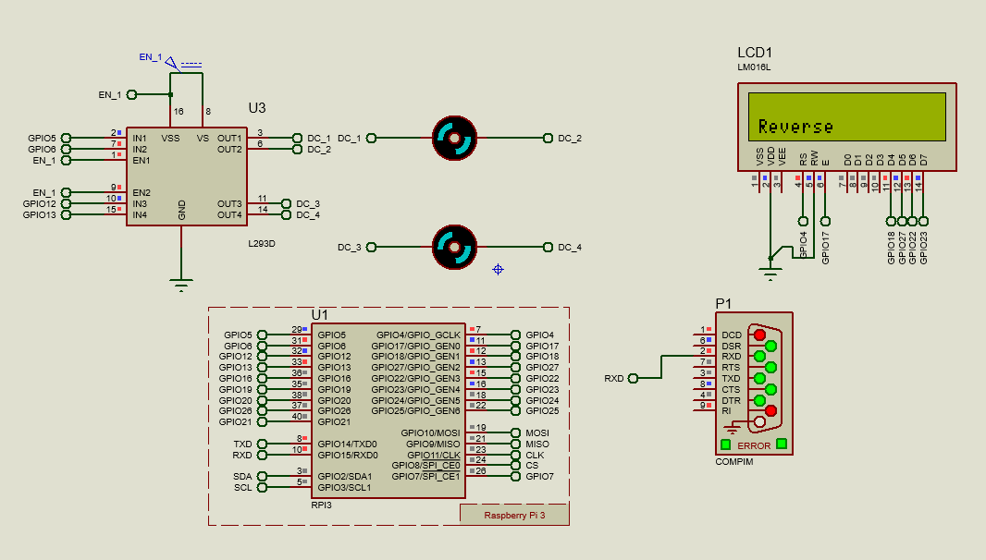
STATUS OF PROJECT WORK
Simulation of Smart Wheel Chair
Fig 4.1 Simulation Model of Smart Wheelchair

Slide 21
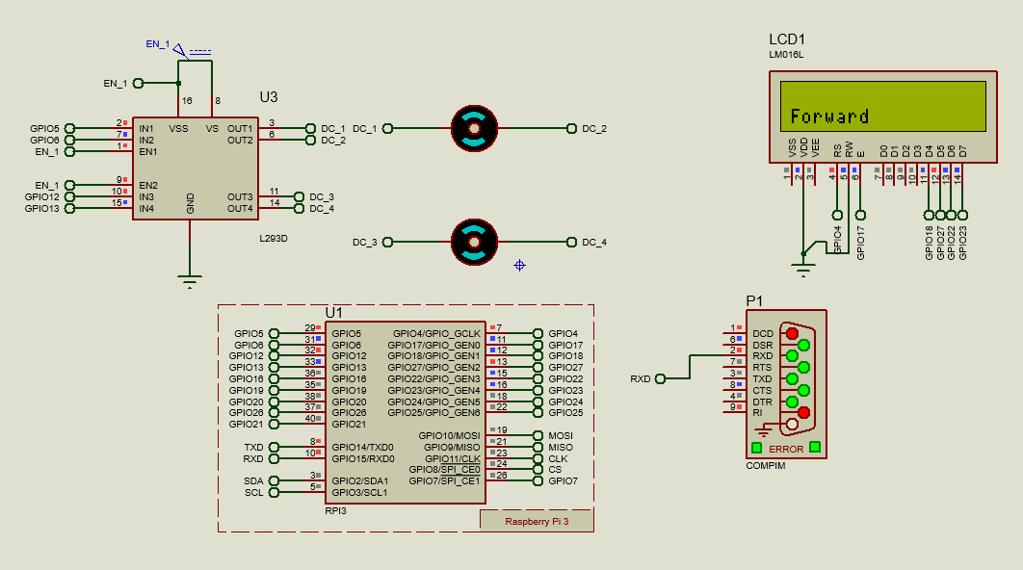
STATUS OF PROJECT WORK
Simulation of Smart Wheel Chair
Fig 4.1 Simulation Model of Smart Wheelchair

Slide 22
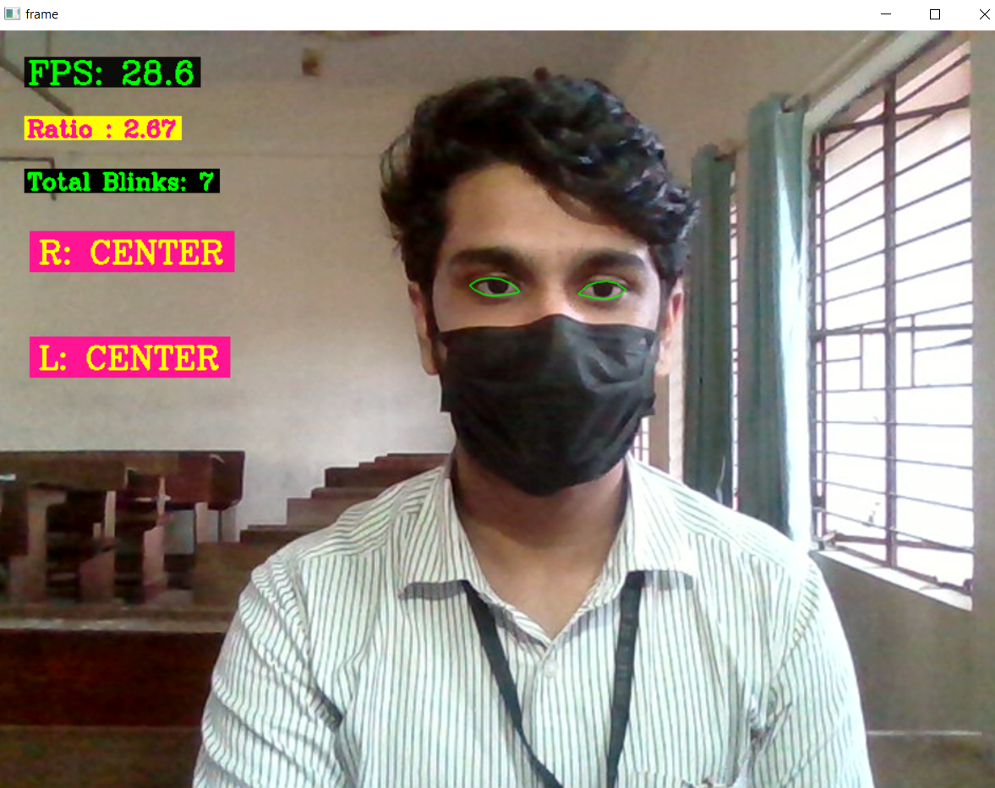
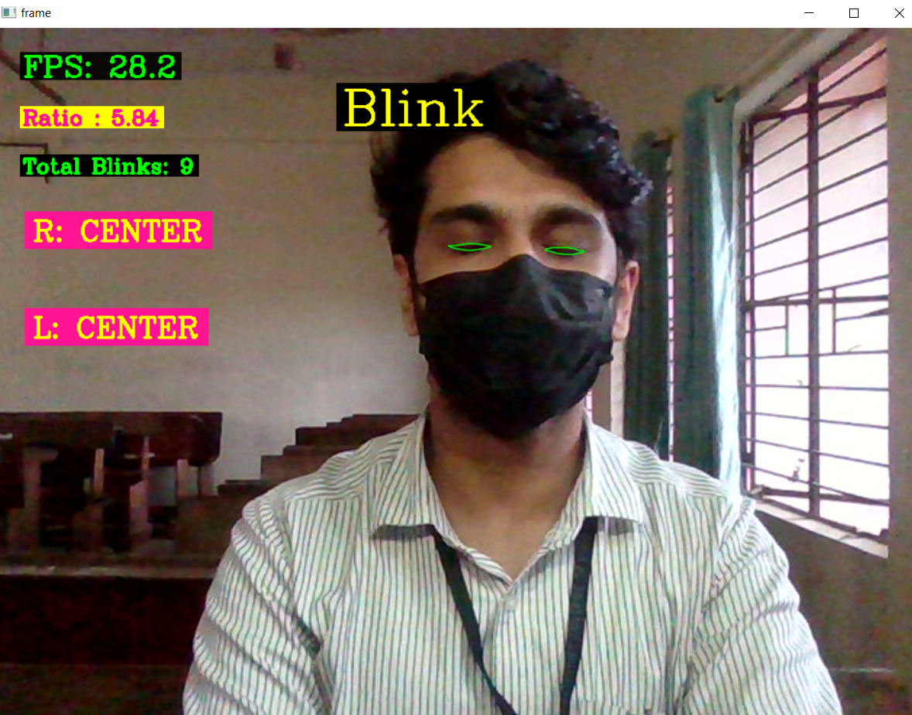
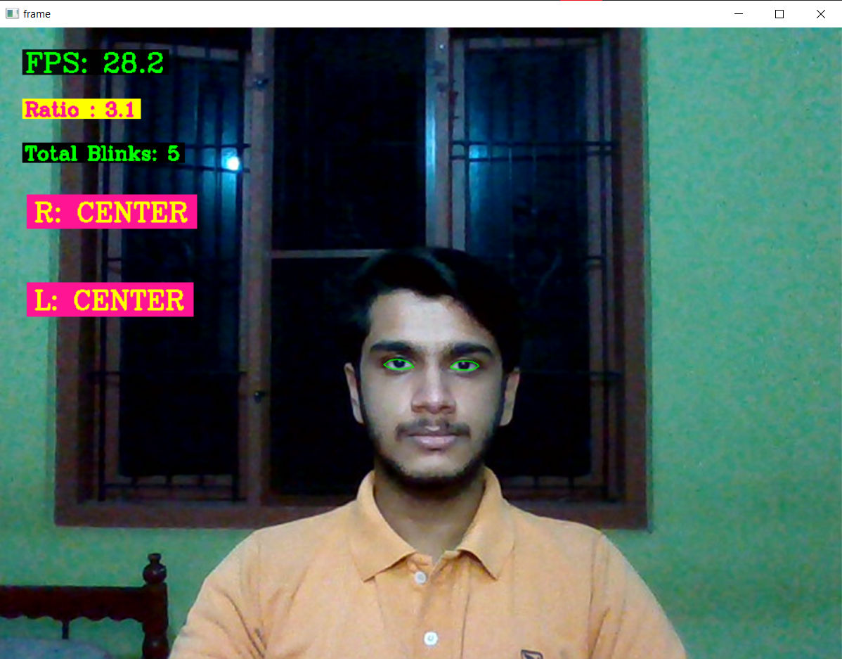
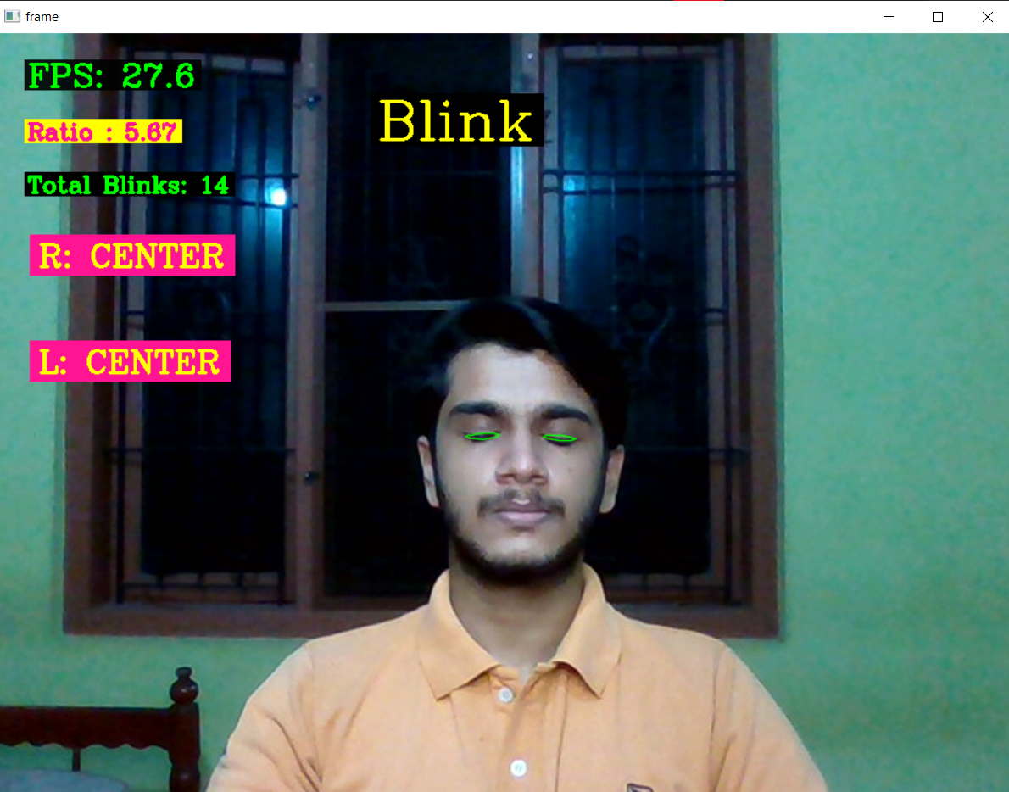
STATUS OF PROJECT WORK
Eye tracking program is developed and its results are shown below.
Fig 2.Straight
Fig 3. Closed

Slide 23
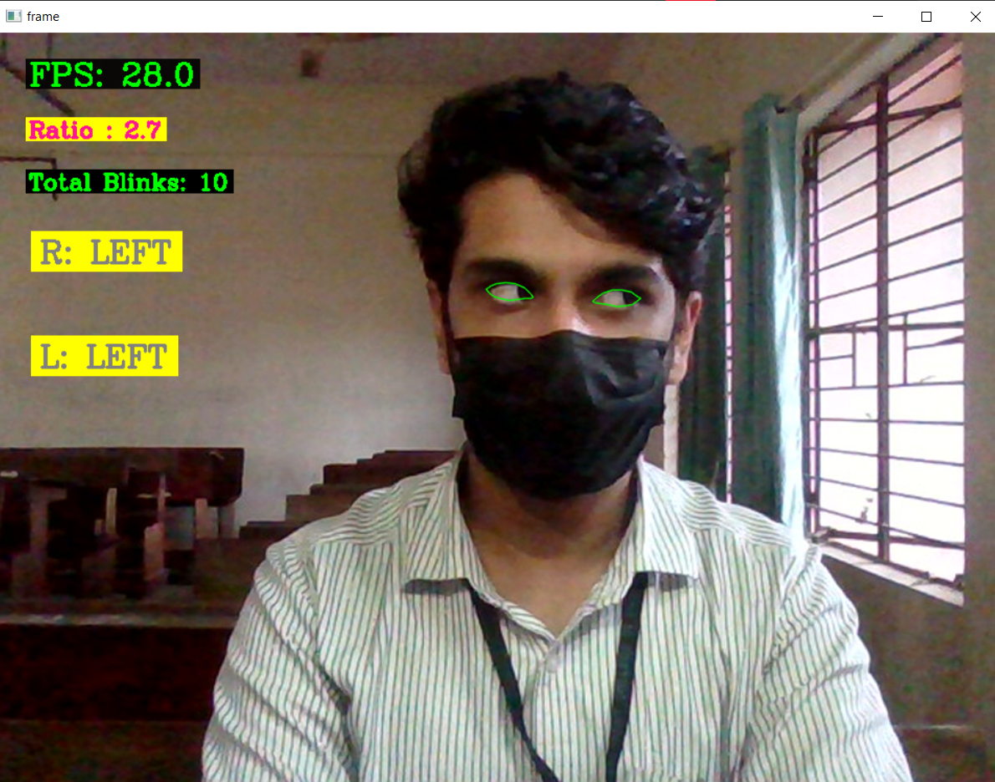
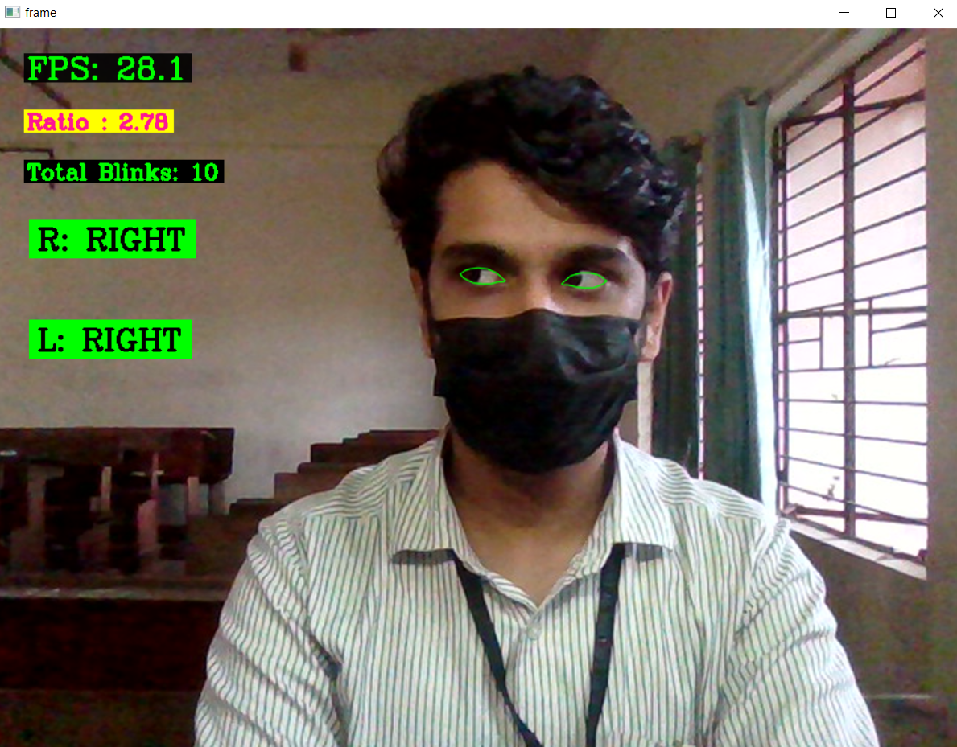
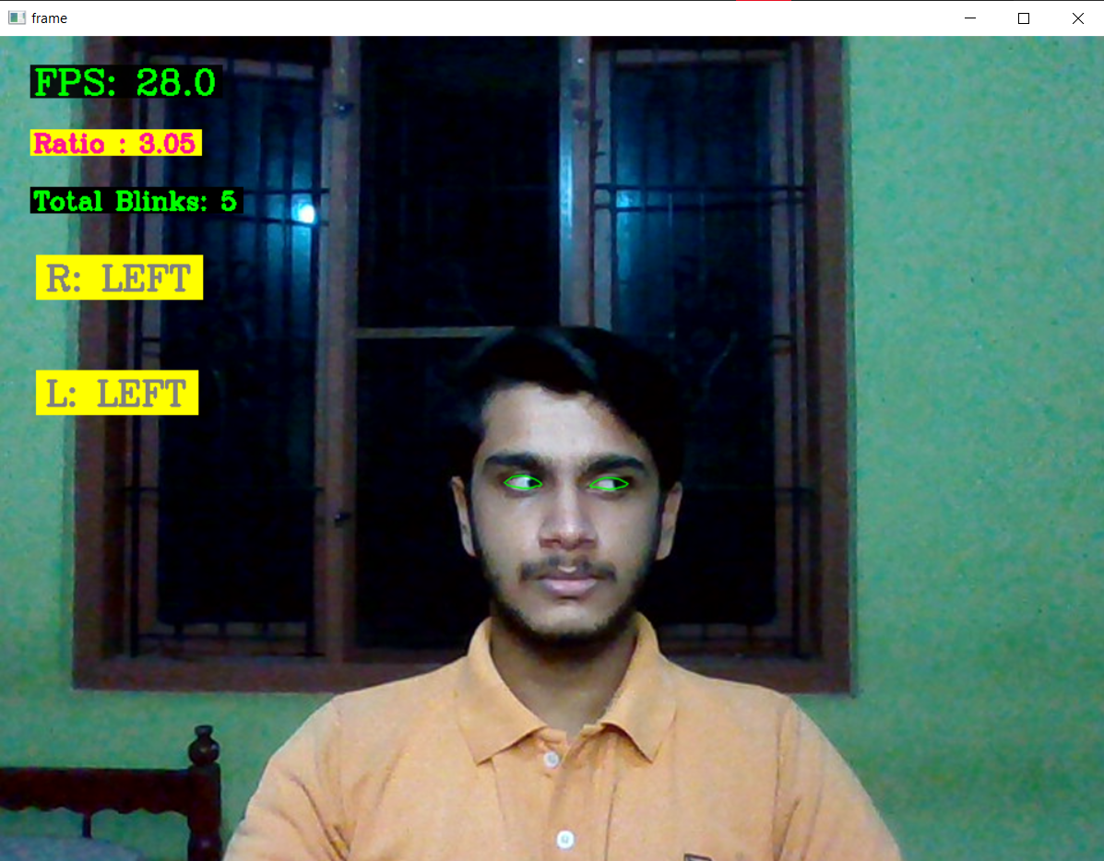
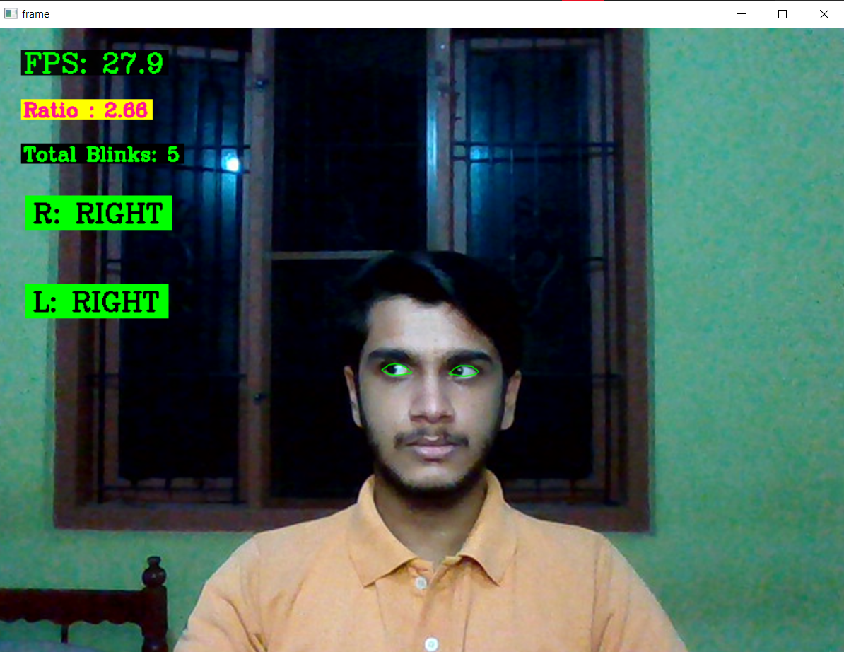
STATUS OF PROJECT WORK
Eye tracking program is developed and its results are shown below.
Fig 4. Left
Fig 5. Right

Slide 24
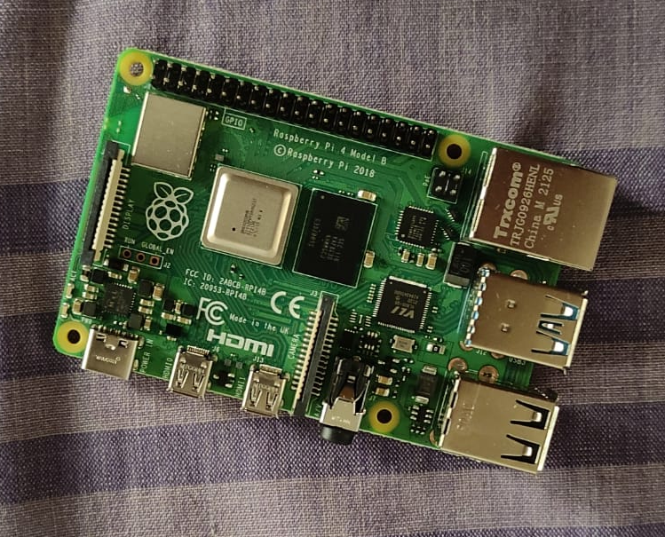
STATUS OF PROJECT WORK
Raspberry Pi 4 have been acquired and tested.

Slide 25
WORK PLAN
Work | Oct 2021 | Nov 2021 | Dec 2021 | 1-2 weeks Jan 2022 | 3-5 weeks Jan 2022 | Feb 2022 | Mar 2022 | April 2022 | May 2022
Topic selection and preliminary works
Literature Survey
Program and train machine learning model for eye tracking.
Simulation of autonomous wheelchair.
Simulation of the circuit for home automation.

Slide 26
WORK PLAN
Work | Oct 2021 | Nov 2021 | Dec 2021 | 1-2 weeks Jan 2022 | 3-5 weeks Jan 2022 | Feb 2022 | Mar 2022 | April 2022 | May 2022
Interface the eye tracker, home automation and wheelchair together.
Hardware implementation of eye tracking glasses.
Hardware implementation of autonomous wheel chair.
Test and solve real time issues.

Slide 27
CONCLUSION
Literature review for the proposed model are done.
Raspberry Pi 4 is acquired and tested.
Eye tracking model is developed.
Simulation of autonomous wheel chair.

Slide 28
REFERENCE
[1]Ahmad F. Klaib1, Nawaf O. Alsrehin1, Wasen Y. Melhem2, Haneen O. Bashtawi2, Aws A. Magableh1. “Eye Tracking Algorithms, Techniques, Tools, and Applications with an Emphasis on Machine Learning and Internet of Things Technologies”, September 2020
[2]Pramodini A. Punde, Dr. Mukti E. Jadhav, Dr. Ramesh R. Manza, “A study of Eye Tracking Technology and its applications”, 2017 IEEE
[3]Tan Kian Hou, Yagasena and Chelladurai“Arduino based voice controlled wheelchair”, 2020
[4]Joseph K George, Subhin K B, Arun Jose,Hima T, “Eye Controlled Home-Automation For Disables”, IOSR, 2019
[5] Deepak Kumar, Reetu Malhotra, S. R. Sharma, “Design and Construction of a Smart Wheelchair”, WEEF, 2019

Slide 29
THANK YOU

